Slide 1
TOP 5 for a person with an intellectual disability
A Guide for Disability Support Staff and Family Carers

Slide 2
TOP 5 is…
designed to assist the hospital staff better understand the individual needs of the person
developed by people who know the person well and include:
any risks eg choking, pica
interests, likes, dislikes, fears/ phobias, rituals/routines
things that might trigger the person to become upset whilst in the hospital setting

Slide 3
What are the benefits of TOP 5?
Better understanding of the person with disability
Important information to keep the person safe
Strategies to support the person if they become distressed
Make it easier for hospital staff to do their job
Improved hospital journey for person with disability

Slide 4
How to develop a TOP 5
Consider the five most important tips or strategies you think disability/health staff need to know to:
Identify risks to the persons safety i.e choking
Keep the person you care for reassured and settled
Gain co-operation in personal care activities
Encourage communication
Acknowledge and support their interests, and sense of self

Slide 5
Each TIP should include:
1. What action the staff need do, or not do
2. Why
3. The expected outcome this will achieve

Slide 6
Consider risks…
What are they?
Choking
Ways to minimise the risks?
Supervision with food
Additional information?
Mealtime Management Plan
Behaviour Management Plan
Absconding
Falling
Aggression etc…
Meal modification
Provide bed near nurses station & supervise closely
Use walker when mobilising
Stand a metre away when speaking to person etc…
Placement of food /drink
Most recent specialist review etc…

Slide 7
Examples…
Mark will climb over bedrails and slide out of the end of the bed. He needs supervision 24/7..
Mother
Mohammed doesn’t like needles and will lash out. He needs you to make it a game, distract him, 2 people to hold his hands. He needs a reward afterwards- give him a clap. Mother
Tina will eat anything including non-edibles. Take care to keep medical supplies etc. out of her reach. All meals must be supervised or she will eat the containers and cutlery. Support Worker

Slide 8
What can help to minimise distress?
What things may cause distress?
unfamiliar people
Are there things or tasks that help settle the person?
a quiet place
Are there set routines developed that keep the person reassured?
at bedtime
noise
colours
words
clothing
visitors
fear of needles
crowds etc…
doctors
cup of tea/coffee
turn the light of
sit in a chair
listen to music
talk to someone on the phone etc…
with meals
with personal care
‘must haves’ – e.g soft toy, buzzer, remote
Preferred activity

Slide 9
Examples…
If you show Hanna the procedure on yourself first, she will then let you do it for her, eg put the Blood Pressure cuff on your arm, then hers. Support worker
Matthew must have a magazine that features girls such as a fashion magazine. He will tuck it under his arm and sit patiently.
Sister

Slide 10
Understanding the person?
What do you need to know about the person?
Use of key word signs
How the person expresses pain, discomfort, fear
What do you need to know about the person?
Behaviours that may be used to communicate a need
Use of communication aids
What will the outcome be?
To build rapport with the person
Gestures & non-verbal cues
Likes and dislikes
Personality
Improve communication and understanding
Improve the persons experience

Slide 11
Examples…
Jonathon has a unique sign for YES: He taps his head with a closed fist. Mother
Brett clicks his tongue when he is thirsty, and he squeals when he smells food. Father
Sophie has a big personality and is fun loving. She likes lots of attention and positive verbal praise. Give her a 5 min warning and rephrase rather than saying ‘No’. Father

Slide 12
Examples…
Tristan is non-verbal, and uses about 20 key word signs and gestures. He will give you a ‘thumbs up’ when he is happy. Father
Saanvi uses Nappies, and is toilet timed. She will tap her groin if she needs to go to the toilet. You need to monitor her bowel movements as she can smear faeces. Mother

Slide 13
NEXT…Write them on the TOP 5 form

Slide 14
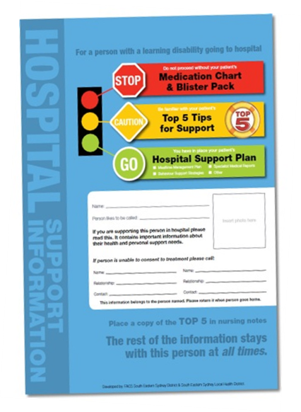
Keep it in the A2D Together Folder
Front Cover – Contacts/Photo
Medication Chart – Blister pack/liquids/inhalers
TOP 5 Tips for support
Hospital Support Plan
Other management plans to support the person in hospital

Slide 15
When admitted to hospital…
TOP 5 is:
A copy is given to hospital staff
TOP 5 is kept with the person at all times in their A2D folder
TOP 5 provides important information to hospital staff who will be interacting with the person during their admission to hospital

Slide 16
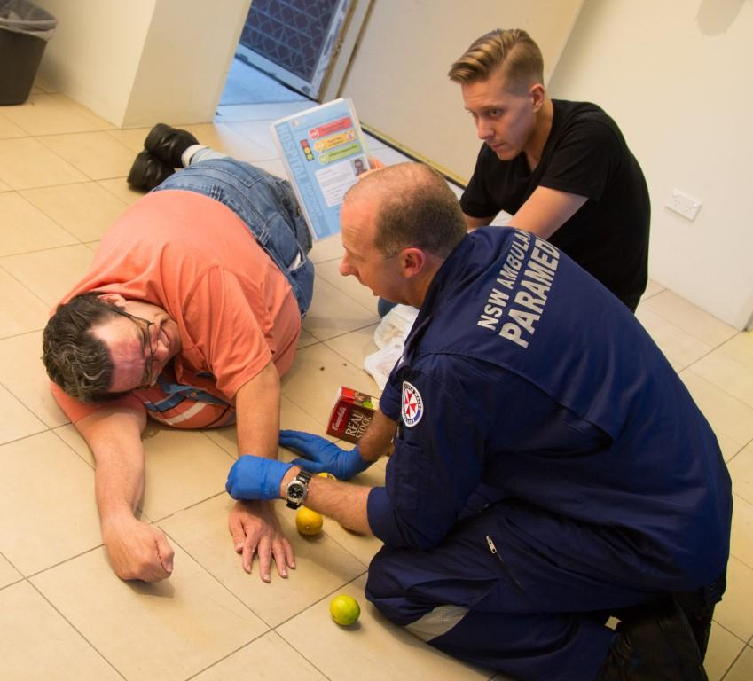
What happens in an emergency?
Give the A2D Together Folder to the Paramedic
Explain the TOP 5
VITAL information for ALL health staff
TOP 5 is especially important if the person is unaccompanied.

Slide 17
Want to know more?
http://www.cclhd.health.nsw.gov.au/patientsandvisitors/CarerSupport/top5
http://www.cec.health.nsw.gov.au/programs/partnering-with-patients/top5

