Slide 1
Admission2Discharge Together
Improving the hospital journey for people with Disability
Notes:
The Admission 2Discharge Together Project has been developed in co-design, involving people with a disability, carers, health and disability staff.
It was developed in response to some of the poor hospital experiences of people with a disability (PWD) from the local area, as well as the increasing evidence of poor health outcomes for this cohort.

Slide 2
Aim
Improve the hospital journey for people
with disability
Notes:
The overarching aim of the project was to improve the hospital journey for people with disability. Some of the strategies were to:
Assist clinical staff to meet the needs of persons’ with disability, who may be non-verbal or display behaviours of concern in the hospital setting.
Increase the integration of care and facilitate a smooth transition in and out of hospital for people with Intellectual Disability.
Implement the Joint Guideline Supporting Residents of ADHC Operated and Funded Accommodation Support Service who present to a Public Hospital (2013).
Support the implementation of the NSW Health Disability Inclusion Action Plan 2015.

Slide 3
Learning Outcomes
Challenges that a person with disability may experience in hospital
Rights of people with disability
Importance of communication
How personal perceptions, values and attitudes impact on the care and support provided to a person during their hospitalisation
Purpose of TOP 5 and the Admission2Discharge Together (A2D) Folder.
Notes:
We will cover these topics in this presentation.
Frequently the challenges are ours or to the system/routine ways of working in a hospital.
People with disability have a right to the support and services that meet their individual needs and to be respected for their human worth and dignity.
Consider the impact of not being understood can have on anyone, and the importance of communication.
Our own individual behaviours and the impact this may have on others.
The use of the A2D Together Folder.

Slide 4
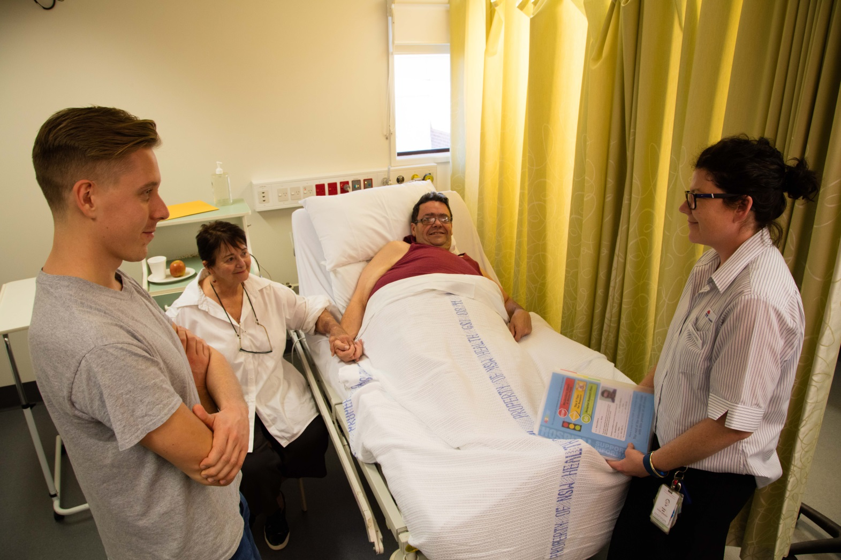
Article 25 of the United Nations Convention The rights of Persons with Disability
Persons with disabilities have a right to the enjoyment of the highest attainable standard of health without discrimination on the basis of disability.
Notes:
One of the biggest barriers to people with disability living fully inclusive lives and having equitable access to services (such as going to hospital) is the attitudes and behaviors of the general community.
This needs to be talked about for change to become possible.
One way to do this is by having:
a shared understanding of a person’s needs
a commitment to raising awareness about the challenges that people with Intellectual Disability still experience every day of their lives.
This will help to promote inclusion and value for all people Disability.
Australia is a signatory to the United Nations Convention which has meant that there has been a change in our laws.
This has led to Disability Reform. Next slide will talk about this…..

Slide 5
NSW Disability Inclusion Act 2014
Acknowledges that people with disability have the same human rights as other members of the community.
Enables people with a disability to exercise choice and control in the pursuit of their goals and the planning and delivery of their supports and services.
Provide safeguards in relation to the delivery of supports and services for people with disability.
Supports the purposes and principles of the United Nations Convention on the Rights of Persons with Disability.
Notes:
Nationally there are a range of Policies to support a change in the way we think about and work with people who have a disability. These include:
National Disability Strategy
National Carers Strategy
NDIS
In 2014 in NSW the Disability Inclusion Act was passed, with a human –rights base. This has been a change from the previous disability legislation.

Slide 6
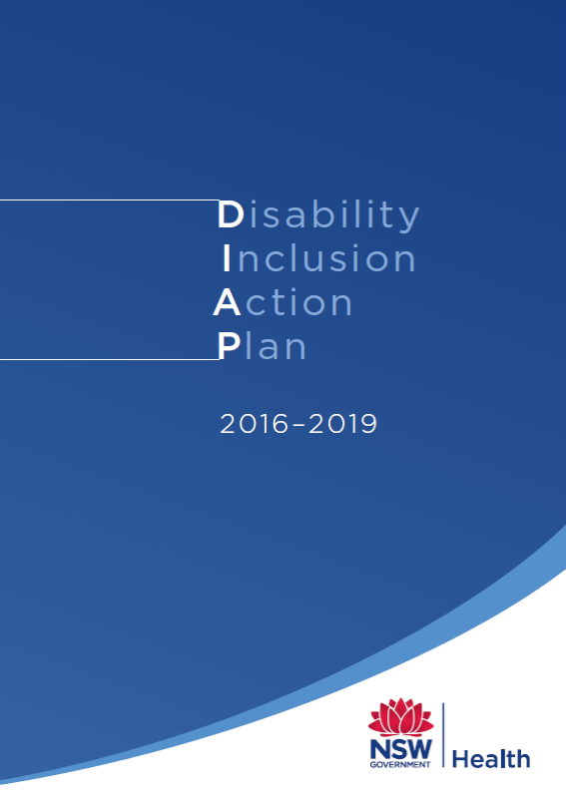
NSW Health Disability Inclusion Action Plan
Four Focus Areas
Promoting positive attitudes and behaviours
Creating liveable environments
Providing equitable systems and processes
Supporting access to meaningful employment opportunities
Notes:
NSW Health has developed the Disability Inclusion Action Plan (DIAP), which underpins all disability work in NSW hospitals and demonstrates NSW Health commitment to The Act.
The aim of the DIAP is to:
Improve to access to information, services and employment for people with disability
Create inclusive culture, organisations and communities

Slide 7
People with intellectual disability
Experience high rates of adverse outcomes during hospital stays
Experience poorer health outcomes overall
Have more difficulty in obtaining the necessary health services in comparison with other populations Khran & Drum 2007
Experience significant medical and mental problems
Conditions often unrecognised, misdiagnosed and poorly managed AIHW 2008;Lennox & Kerr
Notes:
So, we need to consider why is it important to have this conversation?
Current research demonstrates these facts about people with Intellectual Disability, and their health.
People with Intellectual disability have negative experiences and poor health outcomes when they go to hospital.
If you have a short story that illustrates adverse outcome use it here.
Evidence is available in the NDS Background Paper People with disability and hospitalisation: Challenges and opportunities in NSW, produced by the National Disability Services NSW in April 2014. http://www.aci.health.nsw.gov.au/__data/assets/pdf_file/0007/307159/NSW_Hospitalisation_background_paper_final.pdf

Slide 8
Ombudsman NSW
Report of Reviewable Deaths in 2014,2015,2016 and 2017 Deaths of people with disability in residential care (2018)
2014-17, the deaths of 494 people with disability in care were reviewed.
64% of deaths were sudden and unexpected
On average people were 55 years old when they died, 25 years younger than the general population
Notes:
The NSW Ombudsman is required by legislation to regularly review all deaths of people with disability living in supported accommodation.
The most recent review of reportable deaths, of the 494 people who died, identified these statistics.
There were many recommendations for addressing some of the issues identified, and the A2D Together Folder has met some of these recommendations.
These findings are also supported by research conducted by Professor Trollor at the UNSW ( BMJ Open (2017: Vol 7, Issue 2.)

Slide 9
Leading causes of death
Nervous system disease (16.1%) mainly epilepsy and cerebral palsy
Respiratory diseases (15.5%) mainly pneumonia and aspiration pneumonia
Congenital conditions (13.2%) mainly Down Syndrome
Neoplasms (13.2%) mainly colon and breast cancer
Circulatory diseases (11.8%) primarily ischaemic heart diseases
External causes(5%) mainly choking on food
Notes:
The Ombudsman's Review identified these as the 5 leading causes of death. https://www.ombo.nsw.gov.au/news-and-publications/publications/annual-reports/reviewable-deaths-vol-1/report-of-reviewable-deaths-in-2012-and-2013-volume-2-deaths-of-people-with-disabilities-in-care
Some of these preventable deaths reflect the low levels of screening e.g. for breast and cervical cancer.
In our experience in this Local Health District, choking is a very common risk for many of the residents of group homes.
Many of the residents have meal management plans to help ensure their safety.

Slide 10
Respiratory Diseases
Multiple risk factors include:
swallowing difficulties
reliance on others for assistance with meals
mobility problems
Notes:
Looking more closely Respiratory Diseases, which was the leading cause of death in the Ombudsman's Reviewable Deaths Report of 2015 .
These results are possibly due to:
The increase in the age of people with disability living in supported accommodation
Swallowing difficulties
Complex Health needs
Multiple medications
Illnesses not being recognised

Slide 11
Other factors impacting quality patient care
Limited knowledge of the rights of the person
Limited understanding of person’s specific needs
Faulty perceptions and attitudes such as:
“People with intellectual disability are unaware of what’s going on around them”
“They don’t matter “
Notes:
There are other factors that can impact upon someone's hospital experience.
Through this project we have been able to build a bridge between the disability and health sectors.
It has also been possible to increase health staff awareness and understanding of people with disability, and to reflect upon our own attitudes and beliefs.
A lack of understanding of the needs of some people with Intellectual Disability and negative attitudes play a big role in the type of care the person with a Disability may receive in public hospitals.

Slide 12
Residents living in supported accommodation
As they age and it is expected their health needs and admissions to hospital will increase
Have unplanned admissions through the emergency department(ED)
Have longer hospital stays and repeated admissions
Disability Support Staff (DSW) provide 24 hour support to residents. They are not medically trained
Notes:
For people who live in supported accommodation it is likely that they will have more admissions to hospital as they age.
It is important for health staff to know a little about the staff of supported accommodation, as it influences discharge planning.
Health staff are largely unaware of the training and skills provided to the staff working in disability services.
Health and disability services also operate within very different frameworks.
Disability support workers operate under different industrial awards that influence what they can and can’t do.
An example of this is when a person’s mobility changes as a result of their hospitalisation, and they need a hoist to transfer. The disability support workers will need to have manual handling training BEFORE the person is discharged from hospital.
This highlights the importance of commencing discharge planning as soon as possible, and identifying all community supports the person may have and involving them in this discussion.

Slide 13
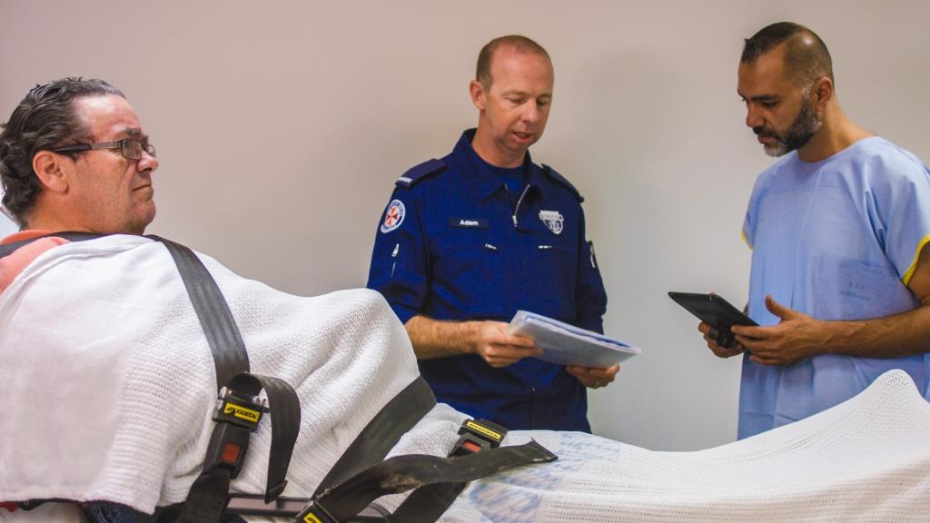
Additional challenges in the hospital setting
Communication barriers
Complex behaviors/mental illness
Fear and anxiety in unfamiliar environments
Relevant information not being provided or getting “lost’
Lack of understanding of person’s specific needs
Notes:
There are many additional challenges experienced by a person with a disability when they are admitted to hospital.
People in the community, supported by disability support workers lead lives that give them a sense of security and predictability.
This is achieved by having set routines and rituals. When in hospitals all of these routines are disrupted and taken away which may cause them to feel extremely anxious and unsettled.
People sometimes are sent to hospital with either too much information or nothing at all.
58% of all people with intellectual disability will experience mental illness sometime in their life due to :
Neurological differences in the brain – MOST important cause
limited quality of life
Medication

Slide 14
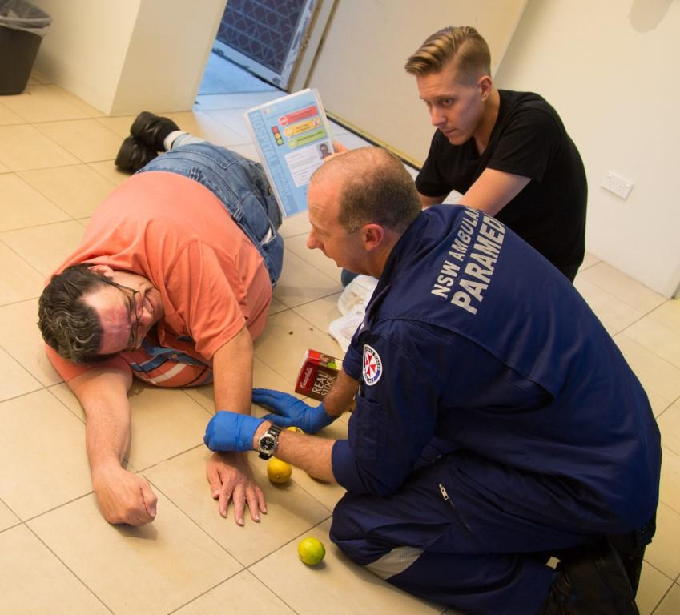
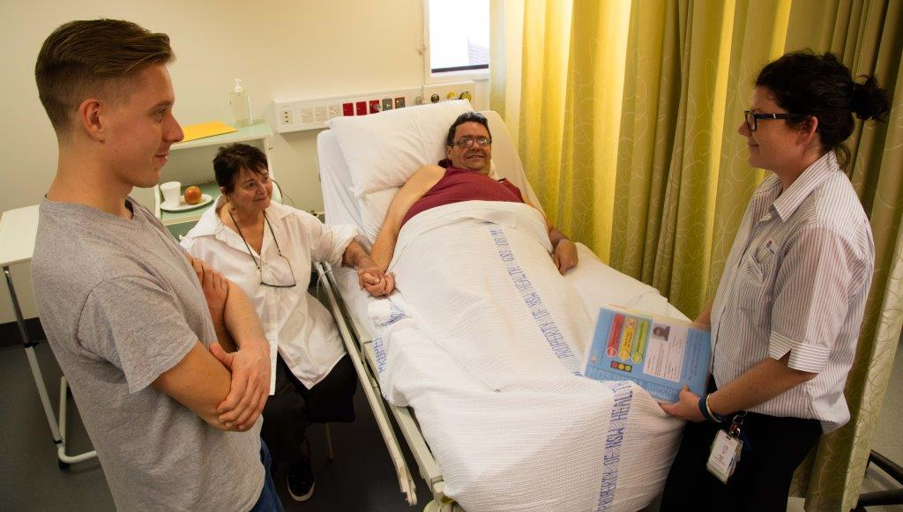
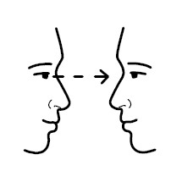
It’s ALL about Communication
Notes:
Communication has been identified as the number one issue that causes barriers and challenges to the patient, carers, families and disability support staff. This includes:
Communication between client and health staff
Communication between support workers and health staff
Communication between staff, shifts and wards and units within the hospital
Think about how you could tell the person next to you how you feel today without speaking.

Slide 15
Often the barrier to the person is us…
It is important to listen to understand
what the person is saying
Our aim is to:
Treat every person with dignity and respect
Communicate with them as an individual
Facilitate a barrier free environment for them
Notes:
It is important to eliminate the disadvantage and improve access to hospital through better systems and processes .
As health professionals, by removing the barriers and changing attitudes we can make this happen.

Slide 16
Communication Challenges
Some residents are non-verbal and communicate through signs, gestures and behaviours
Communication may not be straightforward, support may be needed to ensure their needs are met and that they are heard
The person may use communication aids
Do not assume that the person will have communication barriers because they have a disability, but they may.
Notes:
If a person is not able to speak, they will have their own method of communication.
When we meet a person who doesn’t use words to communicate we need to look at the other ways that the person may be communicating with us - gestures, finger spelling, keyword sign, eyes, behaviours.
All behavior has a purpose and it is our job to find out what the behavior is trying to tell us
If we listen there is a good chance we will hear what the person is trying to say. It will take a few extra minutes, but it is worth it.
ASK the people who know them well, this will be the carer, family or Disability support worker. Include them in the persons care planning.
Look in the A2D Together Folder- it will contain the keyword signs the person uses.
*****Watch the Film Clip – Bruce has had a fall to see how important communication is. http://www.a2d.healthcare/

Slide 17
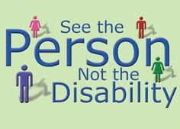
Attitudes and Beliefs
Our attitudes can change almost anything
If your attitude towards the person in your care is positive then this will influence the way in which you care for the person.
Notes:
Some of the factors that influence peoples attitude to others is unfamiliarity, fear and preconceived ideas.
Seeing the person, not the disability is a great way to increase awareness and shift perceptions.
By attending a presentation like this, and doing some further education, you can speak out, share your knowledge and help others to see the person not the disability.

Slide 18
Hospital are scary!
Behaviours of concern may mean that the person:
Has pain - unable to tell you.
Has past negative experiences in hospital
Is frightened - unfamiliar people or too busy or noisy environment
Has a mental illness
Does not understand what’s going on around them
Be experiencing all of the above
Notes:
So lets think more about what a hospital admission is like for someone with an intellectual disability.
People with intellectual disability have not always been treated very well in their lives. They have not had their individual needs met, are denied access to things we take for granted, have been misunderstood and had their rights violated.
More than 60% of people with intellectual disability will also be diagnosed with mental illness at some point in their lives. They may also live very isolated lives so going to hospital can be an extremely traumatic experience.
Consider the impact of not being able to express your needs.
Frequently the only way someone can express these feelings are through their behaviour.
Remember – the concern is ours, not the persons, and that all behaviour is communication.

Slide 19
James’ Story
James is a 47 year old man who lives in a group home
James has an intellectual disability and is non verbal
He communicates with signs and gestures
James has autism.
Notes:
This is James’s story. He is now 47 years old.

Slide 20
James was taken to ED. He was very agitated and tried to get out of the bed . The doctor was having difficulty taking bloods.
5 people were needed to restrain James so bloods could be taken
James was discharged into the care of his parents.
They were informed that restraint was used to take blood.
When he was 17
James was staying at respite while his parents went on their first holiday since he was born
Lifelong
Impact
Taken to Emergency
Home
Ambulance
30 years later…medical procedure that involves needles is still very traumatic.
His parents are convinced that this trauma could have been avoided if he was supported differently in hospital all those years ago.
He was unwell so the DSW called 000 and asked for ambulance assistance. The DSW was unable to go to the hospital with him
.
James parents were contacted by the respite staff.
It took them a few hours to return from holiday. James was very distressed when they arrived.
.
.
.
20
Notes:
Talk through James’s Story.
It clearly demonstrates the long lasting impact the trauma experienced as a 17 year old, now 30 years ago.
We need to be mindful of this and try to understand what it is like from the persons point of view.
Many people can relate to the analogy of a dental phobia- usually as a result of treatments a as child!

Slide 21
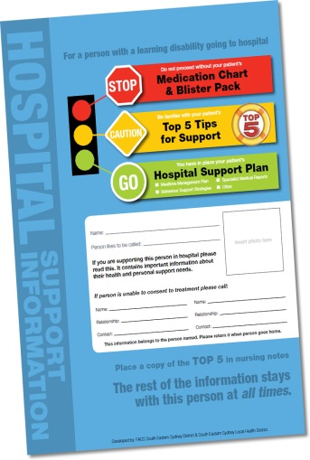
A2D Together Folder
Front cover – Contacts/photo
Medication chart and Webster Pack
TOP 5 tips for support
Hospital Support Plan
Mealtime Management Plan
Other relevant plans to support the person in hospital
It is important that this information stay with the person at all times
Notes:
This information helps clinical staff to understand the persons specific needs. It will also make it easier for them to do their job.
The A2D Together Folder was developed in collaboration with disability and health staff. It consists of a number of sections.
The Front Cover
Includes:
a photo to show what the client looks like when well
contact information at the bottom of the page allows quick access to the relevant decision makers in the clients life
The traffic light is used as the information in the RED section is vital = medication
The information in the ORANGE section is needed to be able to proceed communicating with or reassuring the client
The information in the GREEN section includes medical history, and other planning needs of the person. For example- Hospital Support Plan, mealtime management plan, behaviour support strategies (if applicable for that person)
Use a sample folder to show the sections.

Slide 22
End of life plans
- Authorised care plan or/and
- Palliative care plan
- In the front section of their folder
- Highlighted on the cover page of the A2D Together Folder
Notes:
The A2D Together Folder can also be used for residents who have a palliative care plan.
If the resident has this then it is recommended that this sit in the RED section of the folder so it’s the first thing that the paramedic or the hospital staff see.

Slide 23
Consent to medical treatment
Medical Practitioners - legal and professional responsibility to obtain consent to treatments
If patient unable to consent - seek consent from the patient’s ‘person responsible’ (The Guardianship Act 1887)
Disability Support staff are not permitted to consent to medical treatment.
Their role is to support the patient and provide the name of the ‘person responsible’ A2D Together Folder
Notes:
Medical Practitioners have a legal and professional responsibility to gain consent to treatments before treating a patient.
If the patient is not capable of consenting to their treatment, the doctor must seek consent from the patient’s ‘person responsible’. This is required by the Guardianship Act 1887
Disability Support staff are not permitted to consent to medical treatment.
Their role is to support the patient and provide the name of the ‘person responsible’ which is available on the front cover of the A2D Together Folder.
Refer to ‘Fact Sheet’ from NCAT http://www.ncat.nsw.gov.au/Documents/gd_factsheet_consent_to_medical_or_dental_treatment.pdf

Slide 24
Treatment considered urgent and necessary
Save patient’s life
Prevent serious damage to health
Prevent or alleviate significant pain or distress
No Consent is required
Notes:
This is the Doctors to make this decision and the reason for decision must be recorded by the Doctor.

Slide 25
TOP 5 is…
designed to assist the hospital staff better understand the individual needs of the person
developed by people who know the person well and include:
any risks eg choking, pica
interests, likes, dislikes, fears/ phobias, rituals/routines
things that might trigger the person to become upset whilst in the hospital setting
Notes:
The Orange section contains the TOP 5.
This is developed by someone who knows the person well. It is designed to provide the five most important tips or strategies health staff need to know to:
Identify risks to the persons safety i.e choking
Keep the person you care for reassured and settled
Gain co-operation in personal care activities
Encourage communication
Acknowledge and support their interests, and sense of self

Slide 26
Tips for communicating
Read the TOP 5 and hospital support plan
Address the person by their name
Speak directly to the person (not support staff)
Speak normally (no shouting)
Make eye contact
Allow personal space
Use appropriate language
Allow time to communicate/ don’t rush the person
Respect the person
Notes:
Sometimes it is a bit scary when you meet a person with a disability for the first time.
These are some hints for what you can do to make a connection with the person.

Slide 27
Bill’s journey
Bill was sent home – arrived at 7am in a calm state. He had:
- A2D folder
- Follow up appointment
- Discharge summary
NO NEEDLES!
Medical Officer READ A2D Folder and
contacted Disability Staff at Group home
Arrived unaccompanied to ED
Paramedic gave A2D Folder to Triage nurse
Fell at home- 2am
Head wound & injured shoulder
Taken to Emergency
Home 7am
Ambulance called
Benefits & Savings for:
Client
Medical Staff
Nursing/Allied Health staff
Organisation
Head wound Glued – no needles
No blood taken
Information shared – joint decision made for best treatment
DSW gave Paramedics his A2D Folder
.
Notes:
To finish, lets hear from 55 year old William – who only answers to Bill! His hospital experience was supported through having an A2D Together Folder, which went to hospital with him.
Bill lives in a FACS group home. He is unable to speak, suffers from epilepsy and is very scared of needles. He fell at the group home at 2 am, sustaining a deep cut on his head, and landed on his shoulder. The Disability Support Worker on duty was a casual worker, she called an ambulance. As there was only one staff member on, Bill went by ambulance to Emergency Department (ED) unaccompanied, The worker handed his A2D Together Folder to the paramedic.
On arrival to ED, the paramedic handed that folder to the triage nurse. The doctor on duty also read his folder, noted the strategies on his TOP 5 which included “please call me Bill” & outlined his fear of needles.
The doctor was worried about Bill’s epilepsy and by using the details on the front page was able to contact the group home staff. Bill’s recent blood results were shared, and were in a therapeutic range.
The Doctor and the Disability Support Manager together planned an acceptable treatment and his head wound was glued. Bill stayed calm and cooperative and was then sent home with no unnecessary tests or procedures.
At 7am he was back in bed- with a follow up appointment, a discharge summary and an almost unheard of 5 hour turnaround!

Slide 28
What worked for Bill?
He had his A2D Together Folder.
It included:
TOP5
Hospital Support plan
Other relevant information
Health staff read and used the A2D Together Folder, worked together with Disability Staff to provide safe, person centred care.

Slide 29
More Information
A2D Together Website: www.a2d.healthcare
Further education available
e-HETI online for NSW Health staff about Disability & Carers
Idmh e-learning UNSW
Agency for Clinical Innovation (ACI) : The Essentials
National Roadmap for Improving the Health of people with Intellectual Disability
Content correct at time of development November 2021

